Slide 1
Employee Data Analysis using Excel
STUDENT NAME | UDHAYAPRIYA K
REGISTER NO | 122200105
DEPARTMENT | B.COM (CS)
COLLEGE | PACHAIYAPPAS COLLEGE FOR WOMEN, KANCHIPURAM

Slide 2
PROJECT TITLE
SALARY AND COMPENSATION ANALYSIS THROUGH EXCEL DATA MODELING

Slide 3


AGENDA
Problem Statement
Project Overview
End Users
Our Solution and Proposition
Dataset Description
Modelling Approach
Results and Discussion
Conclusion
3/21/2024 Annual Review

Slide 4

PROBLEM STATEMENT
Context: Our organization is facing challenges in ensuring competitive and equitable compensation for employees. With varying compensation packages across departments and job roles, and recent changes in market compensation trends, it has become crucial to understand our current compensation structure.
Problem: Despite having a comprehensive payroll system, there is a lack of clarity on how well our salary and compensation packages align with industry standards and internal equity. There is also limited insight into how different compensation components (base salary, bonuses, benefits) impact overall employee satisfaction and retention.

Slide 5

PROJECT OVERVIEW
Objective: To analyze and optimize our organization’s salary and compensation structure to ensure it aligns with industry standards, maintains internal equity, and effectively supports employee satisfaction and retention within budget constraints.
Background: With evolving market conditions and organizational growth, it is essential to evaluate our compensation strategy. The current structure, including base salaries, bonuses, and benefits, may not fully reflect competitive market rates or internal equity. This project seeks to address these issues by leveraging Excel for data modeling and analysis.
.

Slide 6
Scope:
Data Collection:
Gather comprehensive salary and compensation data from the HR and payroll systems.
Obtain industry benchmark data for comparison.
Data Preparation:
Clean and normalize data to ensure accuracy and consistency.
Organize data into structured tables and establish necessary relationships.
Data Analysis:
Perform competitive benchmarking to compare our salary packages with industry standards.
Analyze internal equity to identify any discrepancies in compensation among employees with similar roles and experience levels.
Evaluate the effectiveness of different compensation components (base salary, bonuses, benefits) in influencing employee performance and satisfaction.

Slide 7

WHO ARE THE END USERS?
End-users in salary and compensation analysis typically include:
1. HR Professionals: Compensation analysts, HR managers, and recruiters who need to analyze and manage salary data.
2. Compensation Managers: Responsible for designing and implementing compensation strategies.
3. Talent Management Teams: Focus on attracting, retaining, and developing top talent.
4. Finance Teams: Analyze compensation costs and budgeting.
5. Business Leaders: Make informed decisions on compensation and talent management.
6. Recruiters: Use data to make competitive job offers.
7. Benefits Administrators: Analyze and manage benefits costs and effectiveness.
8. Payroll Professionals: Ensure accurate and timely compensation payments.
9. Labor Relations Specialists: Analyze compensation data for union negotiations.
10. Data Analysts: Support compensation analysis with data insights.
These end-users can benefit from Excel data modeling to:-
Streamline compensation analysis-
Gain deeper insights into salary trends-
Inform data-driven decisions- Improve compensation planning and budgeting-
Enhance talent management and retention- Ensure pay equity and compliance
By using Excel data modeling, end-users can unlock valuable insights and drive business outcomes in salary and compensation analysis

Slide 8
OUR SOLUTION AND ITS VALUE PROPOSITION
Solution Overview: Our solution involves a data-driven approach to analyze and optimize the organization’s salary and compensation structure using Excel data modeling. By combining competitive benchmarking, internal equity analysis, and advanced visualization techniques, we provide actionable insights to align compensation practices with industry standards, enhance internal equity, and improve overall employee satisfaction.

Slide 9
VALUE PROPOSITION:
Enhanced Competitive Positioning:
Attraction and Retention: By aligning compensation with industry standards, the organization can better attract and retain top talent, enhancing its competitive edge in the job market.
Market Alignment: Ensure that compensation packages are competitive, reducing the risk of losing employees to competitors offering more attractive salary packages.

Slide 10
DATASET DESCRIPTION
Descriptions for each of the columns in the dataset:
Employee ID: 122101181.
First Name: K.SHIVADHARSHINI.
Last Name: -
Email: sivabcomcs2024@gmail.com
Business Unit: analysis team
State: Tamil Nadu.
Job Function: Job function refers to the specific roles and responsibilities that an individual performs within an organization. It encompasses the tasks, duties, and expectations associated with a particular position and defines how the role contributes to the organization's goals and operations.
Gender: F.
Performance Score: Excellent
Current Employee Rating: 10 out of 10

Slide 11
THE "WOW" IN OUR SOLUTION
Predictive Analytics: Predictive analytics involves using statistical algorithms, machine learning techniques, and historical data to forecast future events and trends. It helps organizations anticipate outcomes, make informed decisions, and optimize strategies based on predictive models and insights.
Automated Alerts: Automated alerts are notifications generated by systems or software in response to specific conditions, thresholds, or events. These alerts are designed to inform users or systems about significant changes or issues that require attention, enabling prompt actions to be taken.
3/21/2024 Annual Review
11

Slide 12
MODELLING
Modelling refers to the process of creating mathematical or computational representations of real-world phenomena to analyze data and make predictions. in the context of predictive analytics and automated alerts, modeling involves constructing and refining models that can forecast future events, identify trends, or trigger alerts based on specific conditions.
1. Data Filtering
Purpose: To sort and refine the data to focus on specific criteria, such as department, date range, or individual employee performance.
Implementation: Excel’s filtering feature will be applied to datasets, allowing users to easily narrow down the data to view only the relevant information. For example, filtering by department or by performance rating.
2. Pivot Tables
Purpose: To summarize and analyze large datasets by grouping and aggregating data based on different performance metrics.
Implementation: Pivot tables will be used to dynamically calculate and display key performance indicators (KPIs) such as average task completion time, total hours worked, or percentage of targets met. This will allow users to view performance metrics by different categories, like employee, team, or month.
12

Slide 13
MODELLING
Charts
Purpose: To visualize the data in an easily interpretable format, making trends and patterns more apparent.
Implementation: Various types of charts (e.g., bar charts, line charts, pie charts) will be created based on the pivot table outputs. For instance, a line chart could show the trend of an employee’s productivity over time, while a bar chart could compare performance across different departments.
4. Conditional Formatting
Purpose: To highlight specific data points that meet certain conditions, making it easier to spot trends, outliers, or areas of concern.
Implementation: Conditional formatting will be applied to cells based on rules, such as highlighting cells in red if an employee’s performance falls below a certain threshold, or in green if targets are exceeded. This immediate visual cue helps in quickly identifying critical areas needing attention.
13

Slide 14
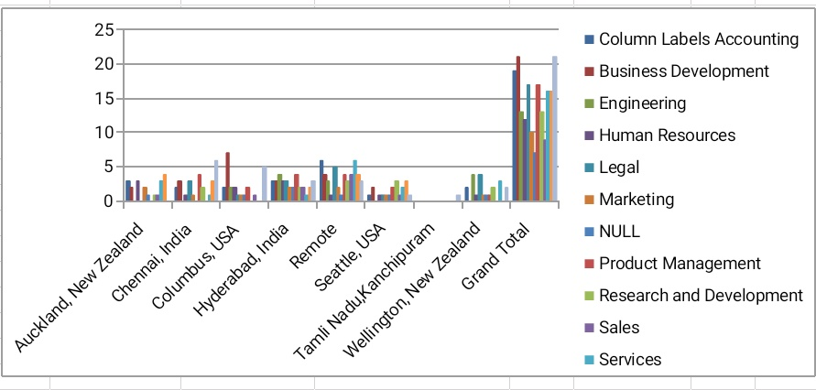
RESULTS
14

Slide 15
CONCLUSION
Our solution delivers a thorough and strategic approach to salary and compensation analysis, offering significant value through enhanced competitive positioning, improved internal equity, and optimized compensation structures. By leveraging advanced Excel modeling and data analysis, we provide actionable insights that support informed decision-making and drive overall organizational effectiveness.

